Slide 1
Transfer Learning

Slide 2
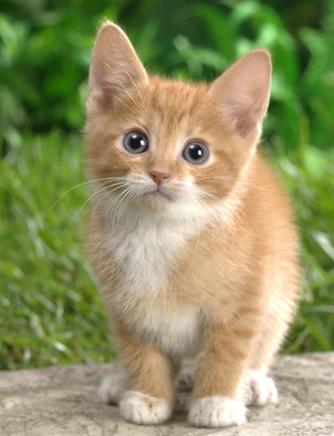
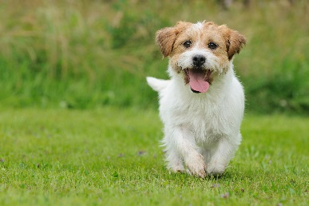
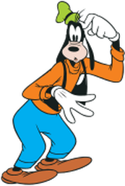

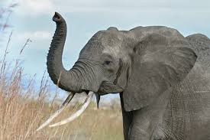
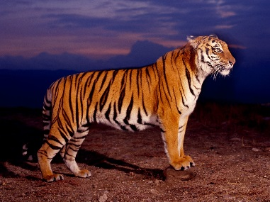
Transfer Learning
http://weebly110810.weebly.com/396403913129399.html
http://www.sucaitianxia.com/png/cartoon/200811/4261.html
Dog/Cat
Classifier
cat
dog
Data not directly related to the task considered
elephant
tiger
dog
cat
Similar domain, different tasks
Different domains, same task

Slide 3

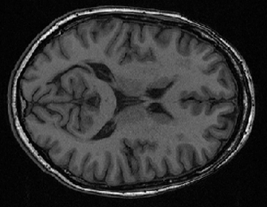


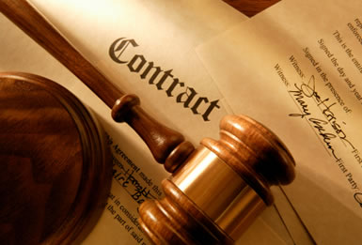
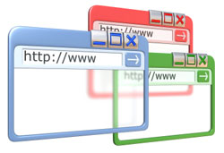
Why?
http://www.bigr.nl/website/structure/main.php?page=researchlines&subpage=project&id=64
http://www.spear.com.hk/Translation-company-Directory.html
Task Considered
Data not directly related
Speech
Recognition
English
Japanese
Chinese
……
Image Recognition
Medical
Images
Text
Analysis
Specific domain
Webpages
Notes:
Transfer
Self-taught

Slide 4
Transfer Learning - Overview
Source Data (not directly related to the task)
labelled
unlabeled
Model Fine-tuning
labelled
Warning: different terminology in different literature
Target Data
unlabeled

Slide 5
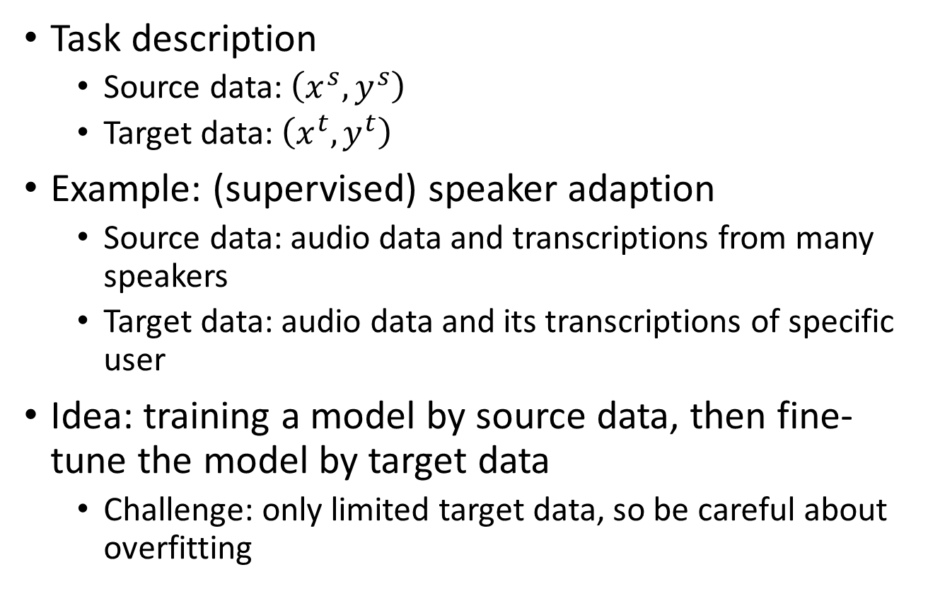
Model Fine-tuning
One-shot learning: only a few examples in target domain
Task description
Source data: $\left(x^{s},y^{s}\right)$
Target data: $\left(x^{t},y^{t}\right)$
Example: (supervised) speaker adaption
Source data: audio data and transcriptions from many speakers
Target data: audio data and its transcriptions of specific user
Idea: training a model by source data, then fine-tune the model by target data
Challenge: only limited target data, so be careful about overfitting
A large amount
Very little

Slide 6
Conservative Training
Output layer
output close
Output layer
parameter close
initialization
Input layer
Input layer
Source data
(e.g. Audio data of
Many speakers)
Target data (e.g. A little data from target speaker)
Notes:
Just train cannot work
Extra constraint
To evaluate how the size of the adaptation set affects the result, the number of
adaptation utterances varies from 5 (32 s) to 200 (22min).

Slide 7
Layer Transfer
Output layer
Copy some parameters
Target data
Source data
Input layer
1. Only train the rest layers (prevent overfitting)
2. fine-tune the whole network (if there is sufficient data)
Notes:
Where shold I add -> I don’t know

Slide 8


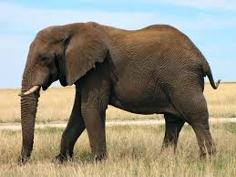




Layer Transfer
Which layer can be transferred (copied)?
Speech: usually copy the last few layers
Image: usually copy the first few layers
Pixels
Layer 1
Layer 2
Layer L
……
……
……
elephant
……
……
……
……
……
……

Slide 9
Transfer Learning - Overview
Source Data (not directly related to the task)
labelled
unlabeled
Fine-tuning
labelled
Multitask Learning
Target Data
unlabeled

Slide 10
Multitask Learning
The multi-layer structure makes NN suitable for multitask learning
Task A
Task B
Task A
Task B
Input feature
Input feature for task A
Input feature for task B

Slide 11
Multitask Learning - Multilingual Speech Recognition
states of French
states of German
states of Spanish
states of Italian
states of Mandarin
Human languages share some common characteristics.
acoustic features
Similar idea in translation: Daxiang Dong, Hua Wu, Wei He, Dianhai Yu and Haifeng Wang, "Multi-task learning for multiple language translation.“, ACL 2015
Notes:
Should I put Tanja’s AF here?

Slide 12
Progressive Neural Networks
Task 1
Task 2
Task 3
input
input
input
Andrei A. Rusu, Neil C. Rabinowitz, Guillaume Desjardins, Hubert Soyer, James Kirkpatrick, Koray Kavukcuoglu, Razvan Pascanu, Raia Hadsell, “Progressive Neural Networks”, arXiv preprint 2016
Notes:
https://arxiv.org/pdf/1606.04671v3.pdf

Slide 13
Chrisantha Fernando, Dylan Banarse, Charles Blundell, Yori Zwols, David Ha, Andrei A. Rusu, Alexander Pritzel, Daan Wierstra, “PathNet: Evolution Channels Gradient Descent in Super Neural Networks”, arXiv preprint, 2017

Slide 14
Transfer Learning - Overview
Source Data (not directly related to the task)
labelled
unlabeled
Fine-tuning
labelled
Multitask Learning
Target Data
Domain-adversarial training
unlabeled

Slide 15

Task description
Training data
Source data: $\left(x^{s},y^{s}\right)$
Target data: $\left(x^{t}\right)$
Same task, mismatch
Testing data
with label
without label

Slide 16
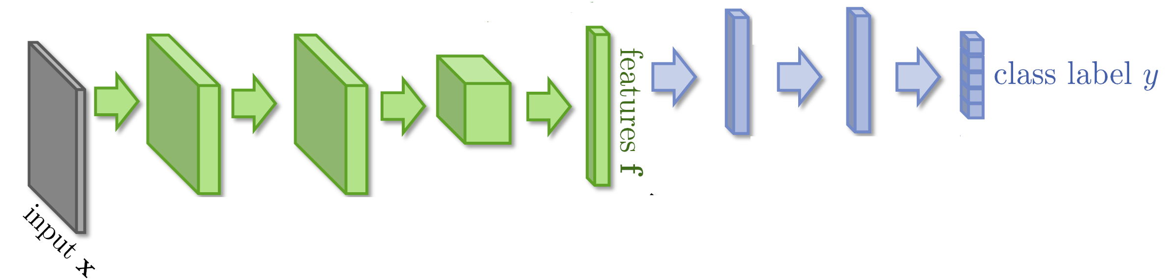


Domain-adversarial training

Slide 17
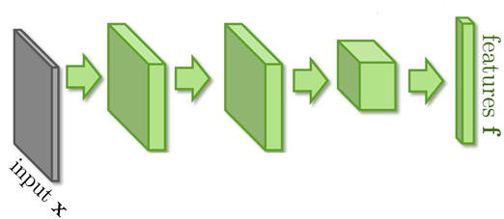
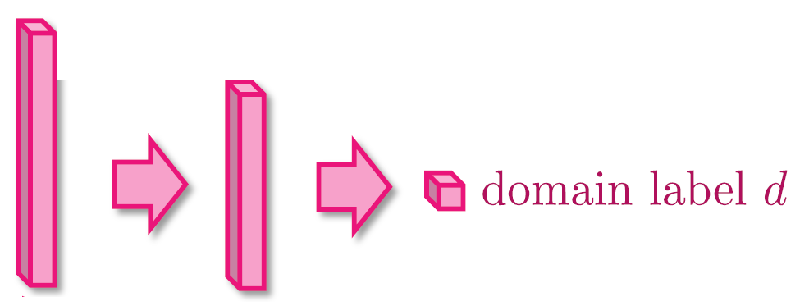


Domain-adversarial training
Similar to GAN
feature extractor
Too easy to feature extractor ……
Domain classifier

Slide 18
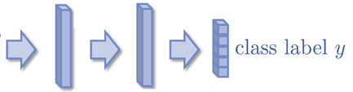
Domain-adversarial training
Maximize label classification accuracy + minimize domain classification accuracy
Maximize label classification accuracy
feature extractor
Label predictor
Domain classifier
Not only cheat the domain classifier, but satisfying label classifier at the same time
Maximize domain classification accuracy
This is a big network, but different parts have different goals.

Slide 19
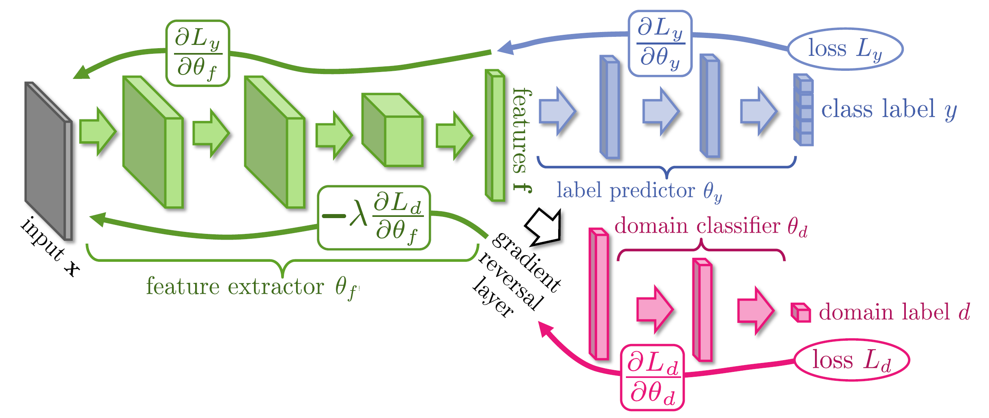
Domain-adversarial training
Domain classifier fails in the end
It should struggle ……
Yaroslav Ganin, Victor Lempitsky, Unsupervised Domain Adaptation by Backpropagation, ICML, 2015
Hana Ajakan, Pascal Germain, Hugo Larochelle, François Laviolette, Mario Marchand, Domain-Adversarial Training of Neural Networks, JMLR, 2016

Slide 20
Domain-adversarial training
Yaroslav Ganin, Victor Lempitsky, Unsupervised Domain Adaptation by Backpropagation, ICML, 2015
Hana Ajakan, Pascal Germain, Hugo Larochelle, François Laviolette, Mario Marchand, Domain-Adversarial Training of Neural Networks, JMLR, 2016

Slide 21
Transfer Learning - Overview
Source Data (not directly related to the task)
labelled
unlabeled
Fine-tuning
labelled
Multitask Learning
Target Data
Domain-adversarial training
unlabeled
Zero-shot learning

Slide 22
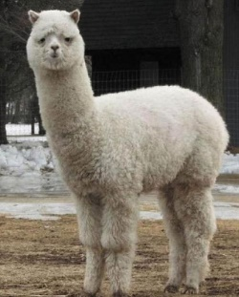
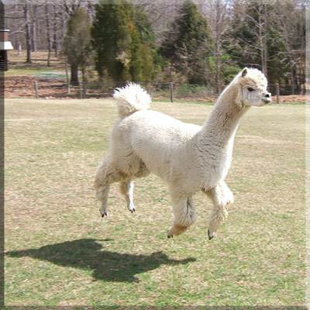

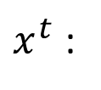
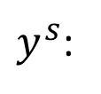
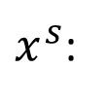
Zero-shot Learning
http://evchk.wikia.com/wiki/%E8%8D%89%E6%B3%A5%E9%A6%AC
Training data
Source data: $\left(x^{s},y^{s}\right)$
Target data: $\left(x^{t}\right)$
Different tasks
Testing data
$x^{s}$:
……
$x^{t}$:
$y^{s}$:
cat
dog
……
In speech recognition, we can not have all possible words in the source (training) data.
How we solve this problem in speech recognition?

Slide 23
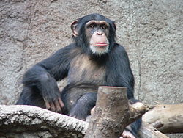

Zero-shot Learning
Representing each class by its attributes
Training
1
0
0
1
1
1
Database
furry
4 legs
tail
furry
4 legs
tail
attributes
 | furry | 4 legs | tail | …
Dog | O | O | O
Fish | X | X | O
Chimp | O | X | X
…
NN
NN
class
sufficient attributes for one to one mapping

Slide 24
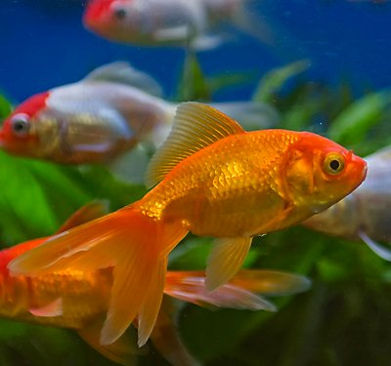
Zero-shot Learning
Representing each class by its attributes
Testing
Find the class with the most similar attributes
0
0
1
furry
4 legs
tail
attributes
 | furry | 4 legs | tail | …
Dog | O | O | O
Fish | X | X | O
Chimp | O | X | X
…
NN
class
sufficient attributes for one to one mapping

Slide 25







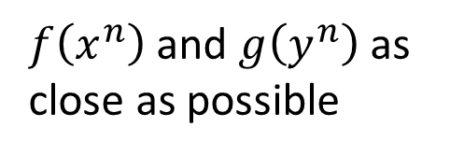
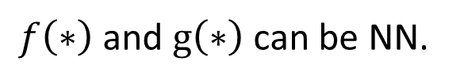
Zero-shot Learning
$f\left(∗\right)$ and $g\left(∗\right)$ can be NN.
Training target:
$f\left(x^{n}\right)$ and $g\left(y^{n}\right)$ as close as possible
Attribute embedding
x²
y¹ (attribute of chimp)
y² (attribute of dog)
x¹
$$f\left(x^{2}\right)$$
$$g\left(y^{2}\right)$$
$$f\left(x^{1}\right)$$
$$g\left(y^{1}\right)$$
y³ (attribute of Grass-mud horse)
$$g\left(y^{3}\right)$$
$$f\left(x^{3}\right)$$
x³
Embedding Space

Slide 26

Zero-shot Learning
What if we don’t have database
Attribute embedding + word embedding
y¹ (attribute of chimp)
x²
V(chimp)
y² (attribute of dog)
V(dog)
x¹
$$f\left(x^{2}\right)$$
$$g\left(y^{2}\right)$$
$$f\left(x^{1}\right)$$
$$g\left(y^{1}\right)$$
y³ (attribute of Grass-mud horse)
$$g\left(y^{3}\right)$$
$$f\left(x^{3}\right)$$
V(Grass-mud_horse)
x³
Embedding Space

Slide 27
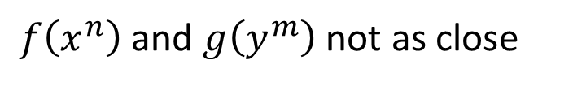
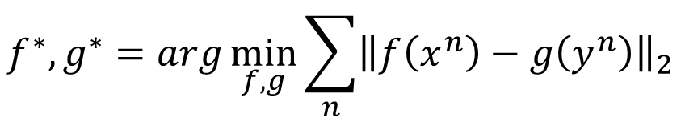
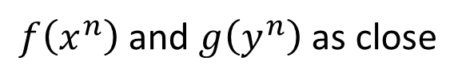

Zero-shot Learning
$$f^{∗},g^{∗}=arg\min_{f,g}{\sum_{n}{{\left\|f\left(x^{n}\right)−g\left(y^{n}\right)\right\|}_{2}}}$$
Problem?
$$f^{∗},g^{∗}=arg\min_{f,g}{\sum_{n}{max\left(0,k−f\left(x^{n}\right)∙g\left(y^{n}\right)+\max_{m≠n}{f\left(x^{m}\right)∙g\left(x^{m}\right)}\right)}}$$
$$f^{∗},g^{∗}=arg\min_{f,g}{\sum_{n}{max\left(0,m−f\left(x^{n}\right)∙g\left(x^{n}\right)+\max_{m≠n}{f\left(x^{n}\right)∙g\left(y^{m}\right)}\right)}}$$
Margin you defined
Zero loss:
$$k−f\left(x^{n}\right)∙g\left(y^{n}\right)+\max_{m≠n}{f\left(x^{n}\right)∙g\left(y^{m}\right)}<0$$
$$f\left(x^{n}\right)∙g\left(y^{n}\right)−\max_{m≠n}{f\left(x^{n}\right)∙g\left(y^{m}\right)}>k$$
$f\left(x^{n}\right)$ and $g\left(y^{n}\right)$ as close
$f\left(x^{n}\right)$ and $g\left(y^{m}\right)$ not as close

Slide 28
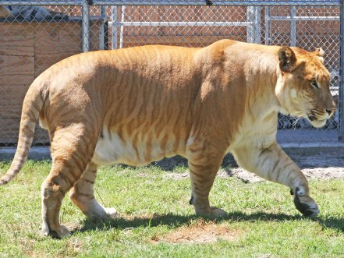
Zero-shot Learning
Convex Combination of Semantic Embedding
lion
tiger
V(tiger)
0.5
0.5
Find the closest word vector
V(liger)
NN
0.5V(tiger)+0.5V(lion)
V(lion)
Only need off-the-shelf NN for ImageNet and word vector

Slide 29
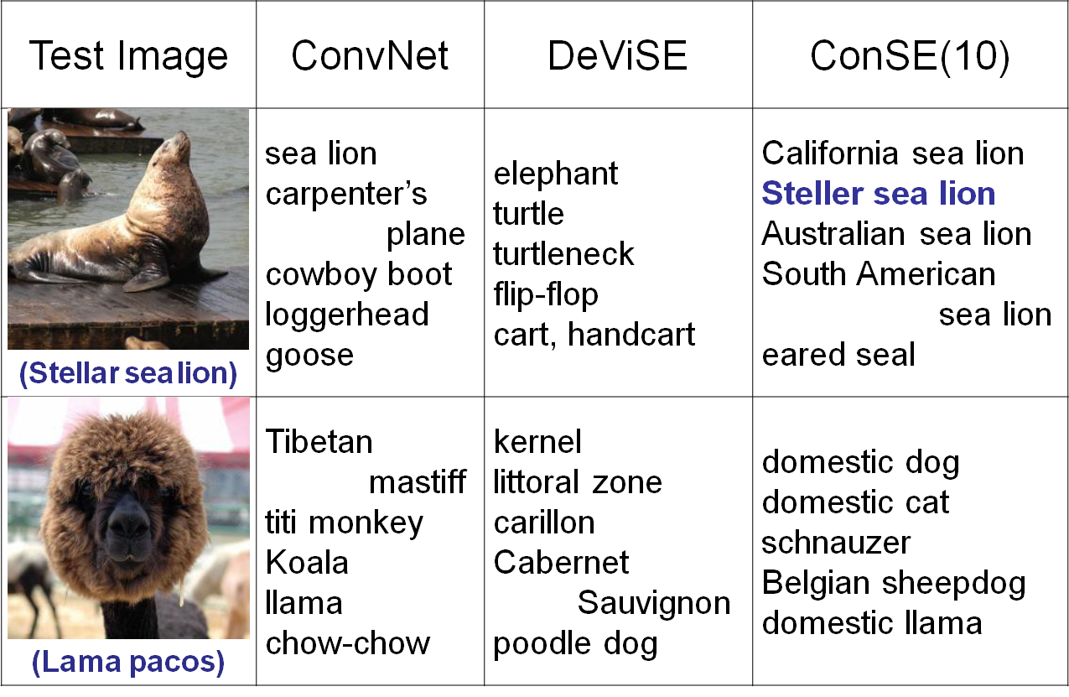
https://arxiv.org/pdf/1312.5650v3.pdf
Notes:
高領毛衣

Slide 30
Transfer Learning - Overview
Source Data (not directly related to the task)
labelled
unlabeled
Self-taught learning
Fine-tuning
Rajat Raina , Alexis Battle , Honglak Lee , Benjamin Packer , Andrew Y. Ng, Self-taught learning: transfer learning from unlabeled data, ICML, 2007
labelled
Multitask Learning
Target Data
Different from semi-supervised learning
Domain-adversarial training
unlabeled
Self-taught Clustering
Wenyuan Dai, Qiang Yang, Gui-Rong Xue, Yong Yu, "Self-taught clustering", ICML 2008
Zero-shot learning

Slide 31
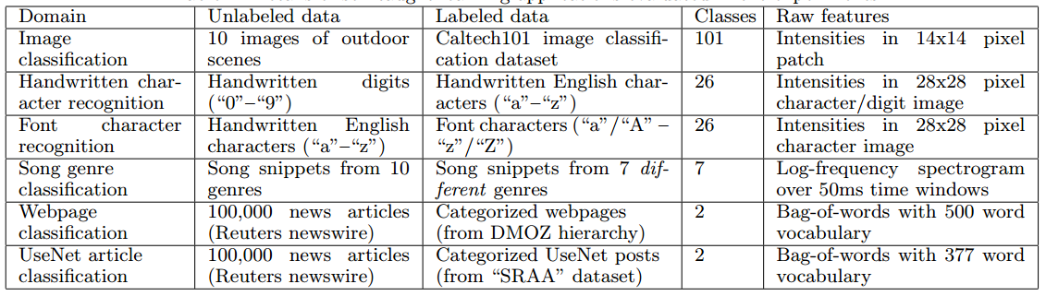
Self-taught learning
Learning to extract better representation from the source data (unsupervised approach)
Extracting better representation for target data

Slide 32
Appendix

